Slide 1
RISC-V TEE Architecture
RISC-V TEE TG meeting
August 16, 2022
Goals, Assumptions, Approach, Plans
Guerney D H Hunt |  | Wojciech Ozga
IBM T.J. Watson Research Center |  | IBM Research - Zurich
presenter

Slide 2
Outline
Goals
Assumptions
Evolution
Threat models
Requirements

Slide 3
Goals
Describe an incremental approach to build trusted execution environment (TEE) for RISC-V.
Support different threat/performance/complexity use cases:
Low-high-tier embedded
Edge
High performance computing (HPC) / cloud
Clarify which features are needed for the full set of RISC-V use cases.

Slide 4
Assumptions
We assume the presence of certain functionalities:
Secure and trusted boot (trusted computing SIG),
IOMMU (IOMMU TG),
Memory system support (Run Time integrity SIG(?)),
Memory controller, paging architecture.

Slide 5
Evolution
Embedded devices -> Edge -> HPC/Cloud.
Proposed iterative approach:
Start with the minimal approach (minimal/no architectural changes).
What are the limitations of this approach?
What can be done to provide more security guarantees, increase performance, scalability?
Propose required changes for more complex TEE models.

Slide 6
Embedded Deployment Models
Non confidential guest OS
Non confidential guest OS
Confidential guest OS
U
Non confidential Application
Non confidential Application
Confidential Application
S
S
Trusted application
M
Firmware
TEE security monitor (TSM)
M
Firmware
TEE security monitor (TSM)
M
RISC-V CPU(s)
RISC-V CPU(s)
RISC-V CPU(s)
Memory Confidentiality, Integrity, Replay Protection, Secure Boot
Root of Trust
Memory Isolation, Confidentiality, Integrity, Replay Protection, Secure Boot
Root of Trust
IOMMU
Memory Isolation, Confidentiality, Integrity, Replay Protection, Secure Boot
Root of Trust
IOMMU
Model 1: Single application deployment (low-end embedded).
Model 2: Multi-application deployment (mid-tier embedded).
Model 3: Multi-OS deployment (high-end embedded).

Slide 7
Modified Deployment Model
Non confidential VM (guest OS)
Non confidential VM (guest OS)
Confidential VM (guest OS)
VU
Non confidential VM (guest OS)
Non confidential VM (guest OS)
Confidential VM (guest OS)
VU
VS
VS
Host OS / VMM
HS
Host OS / VMM
TEE security monitor
HS
Firmware
TEE security monitor (TSM)
M
Firmware
TSM driver
M
RISC-V CPU(s)
RISC-V CPU(s)
Memory Isolation, Confidentiality, Integrity, Replay Protection, Secure Boot
Root of Trust
IOMMU
Memory Isolation, Confidentiality, Integrity, Replay Protection, Secure Boot
Root of Trust
IOMMU
Model 4: M-mode split.
Model 4 (current): M-mode and HS-mode split.

Slide 8
Additional Deployment Models
Non confidential VM (guest OS)
Non confidential VM (guest OS)
Confidential VM (guest OS)
VU
Non confidential VM (guest OS)
Non confidential VM (guest OS)
Confidential VM (guest OS)
VU
VS
VS
Host OS / VMM
HS
Host OS / VMM
HS
TEE security monitor (TSM)
T
M mode Firmware
T
M mode Firmware
M
TEE security monitor (TSM)
M
RISC-V CPU(s)
RISC-V CPU(s)
Memory Isolation, Confidentiality, Integrity, Replay Protection, Secure Boot
Root of Trust
IOMMU
Memory Isolation, Confidentiality, Integrity, Replay Protection, Secure Boot
Root of Trust
IOMMU
Model 5: New stage.
Model 6: Untrusted firmware.

Slide 9
Threat Models
Deployment models operate under different threat models. For example:
Example threat models
 | Cloud/HPC | Edge | High-end embedded | Low-end embedded
Security domains (shared resources) | Multiple tenants | Multiple/Single tenant | Multiple/Single tenant | Single tenant
Local software-level attacker | Untrusted hypervisor | Untrusted hypervisor/OS | Untrusted applications/OS | None
Remote software-level attacker | Yes | Yes | Yes | No (air gapped devices)
Hardware attacker (physical attacks) | No (defense in depth at the data centre level) | Yes/No | Yes | Yes
DMA devices | Yes/No | Yes/No | Yes | Yes/No

Slide 10
Requirements
On the next slide we present the security requirements defined by the community.
We added additional deployment models and introduced changes.
We use the following colour notation:
Assign required security criteria to each deployment model: Isolation, Accessibility, Addressability, Integrity, Confidentiality, Freshness.
No changes compared to the original requirements defined by the community | A definition or meaning changed. | Security criteria accepted by the community | Security criteria that is out of scope for the given deployment model

Slide 11
Category | Security Criteria | Cloud / HPC | Edge | High-end Embedded | Low-end Embedded | Required if | Examples | RVI HC/SIG/TG
Memory Footprint | Stolen/reserved memory | Minimize |  |  |  |  | Recording meta data of secure memory | AP-TEE TG specify
TEE CPU State Protection | State Isolation | Required | Required | Required | Out of scope |  | Prevent untrusted code from arbitrarily accessing/modifying TEE CPU state | AP-TEE TG specify
Memory Confidentiality | Memory isolation | Required | Required | Required | Out of scope |  | Prevent untrusted components from reading TEE memory | AP-TEE TG specify
 | Cipher text read prevention | Optional | Optional | Out of scope | Out of scope |  | Prevent untrusted code from accessing encrypted TEE memory | AP-TEE TG specify
 | Per TEE encryption | Optional | Optional | Out of scope | Out of scope | Multiple security domains | Each VM has one or more unique keys | AP-TEE to recommend
 | Memory encryption strength | Optional | Optional | Optional | Optional |  | Encryption algorithm and key strength | AP-TEE to recommend
 | Number of encryption keys | Optional | Optional | Out of scope | Out of scope |  | Number of TEE keys supported | AP-TEE to recommend
Memory Integrity | Memory integrity against SW attacks | Required | Optional | Optional | Out of scope | Multiple security domains | Prevent SW attacks such as remapping, aliasing, replay, corruption, etc. | AP-TEE TG specify
 | Memory integrity against HW attacks | Optional | Required | Optional | Optional |  | Prevent HW attacks, DRAM-bus attacks and physical attacks that replace TEE memory with old data | AP-TEE to recommend
 | Memory execution isolation | Required | Optional | Required | Out of scope | Multiple security domains | Prevent TEE from executing from normal memory | AP-TEE TG specify
 | Rowhammer attack prevention | Optional | Optional | Optional | Out of scope |  | Prevent untrusted code from flipping bits of TEE memory | AP-TEE to recommend
Shared Memory | TEE controls data shared with untrusted code | Required | Optional | Optional | Out of scope | Multiple security domains | Prevent malicious code from exfiltrating information without TEE consent/opt-in | AP-TEE TG specify
 | TEE controls data shared with another TEE | Required | Optional | Optional | Out of scope | Multiple security domains | Ability to securely share memory with another TEE | AP-TEE TG specify
Memory Assignment | Ability to make memory secure/normal | Required | Optional | Optional | Out of scope | Multiple security domains | Secure memory should be dynamically allocated/unallocated as required | AP-TEE to specify, priviledge architecture
I/O Protection | DMA protection from untrusted devices | Required | Required | Optional | Optional | DMA | Prevent untrusted peripheral devices from accessing TEE memory | AP-TEE TG specify
 | Trusted I/O from trusted devices | Optional | Optional | Optional | Optional | Untrusted devices | Bind devices to TEEs | IOMMU,APTTT to specify
Secure IRQ | Trusted Interrupts | Required | Required | Required | Required |  | Prevent IRQ injections that violate priority or masking | AIA, AP-TEE to specify
Secure Timetamp | Trusted timestamps | Required | Required | Required | Required |  | Ensure TEE have consistent timestamp view | AP-TEE TG specify
Debug Profile | Trusted performance monitoring unit | Required | Optional | Optional | Out of scope |  | Ensure TEEs get correct PMU info; prevent data leakage due to PMU information (fingerprint attacks) | Performance SIG
 | Debug support | Required | Optional | Optional | Out of scope |  | Support debug registers | Debug TG
 | Authenticated debug (Production device) | Required | Optional | Optional | Out of scope |  | Ensure hardware debug prob (e.g., JTAG, SWD) is disabled in production | AP-TEE TG specify
Availability | Untrusted TEE DoS Protection | Required | Optional | Optional | Out of scope | Multiple security domains | Prevent untrusted TEE from refusing to exit | AP-TEE TG specify
 | Untrusted code DoS Protection | Out of scope | Out of scope | Out of scope | Out of scope |  | Prevent untrusted code from refusing to run TEE | N/A ?
Side Channel | Protected address mapping (controlled side channel) | Required | Optional | Optional | Out of scope | Multiple security domains | Similar to memory remapping attacks | uSG SIG, AP-TEE specify
 | u-architectural side channels (branch prediction,..) | Required | Optional | Optional | Out of scope | Multiple security domains | Prevent attacks such as meltdown/spectre (it is difficult to defend agains such attacks in advance) | uSG SIG, AP-TEE specify
 | Control channels, single-step/zero-step defence | Required | Optional | Optional | Out of scope | Multiple security domains | Prevent interrupt/exception injection (combined with cache side channel to leak sensitive data) | uSG SIG, AP-TEE specify
 | Architectural cache side channel | Optional | Optional | Optional | Out of scope | Multiple security domains | e.g. prime probe | uSG SIG, AP-TEE specify
 | Architectural timing side channel | Optional | Optional | Optional | Out of scope | Multiple security domains | Leveraging data dependency timing channels | uSG SIG, AP-TEE specify
Secure and measured boot | Establishes root of trust in support of attestation | Required | Required | Required | Required |  | Knowing that initial firmware is authorised and correct version , … | Security Model TG
Attestability | Remote attestation | Required | Required | Optional | Out of scope | Internet | Prevent fake hardware and software TCB; Prevent malicious hardware debugging in production. | AP-TEE TG specify
 | Mutual attestation | Optional | Optional | Optional | Out of scope | S/U mode | Attestation to another TEE on the same platform | AP-TEE TG specify
 | Remote mutual attestation | Required | Optional | Optional | Out of scope | Internet | Attestation to a TEE on a different platform | AP-TEE TG specify
 | Local attestation | Optional | Optional | Required | Required | Sealing | Verification of attestation by TCB | AP-TEE TG specify
 | TCB versioning | Required | Required | Optional | Optional | Mutable firmware | Prevent TCB rollback | AP-TEE TG specify
 | TCB transparency (and auditability) | Optional | Optional | Optional | Optional | Mutable firmware | TCB elements reviewable | AP-TEE TG recommend
Operational Features | Sealing | Required | Required | Optional | Optional |  | Binding of secrets to TEEs | AP-TEE TG specify
 | Migration | Required | Optional | Out of scope | Out of scope |  | Secure migration of TEEs | Hypervisor SIG, AP-TEE TG specify
 | Nesting | Required | Out of scope | Out of scope | Out of scope |  | Nested TEE Workloads | Hypervisor SIG, AP-TEE TG specify

Slide 12
Current approach
Agreements:
Current approach would meet the needs of cloud scenarios.
Recommend simplification
AP-TEE will have to work with other groups in RISC-V.
Remote attestation is needed.
Recommend additional forms.
Hardware ROT and secure and measured boot.
Small as possible TSM
Provable TSM.
Need (in some models) for an updatable TSM.
Need (for cloud/HPC) to change the classification of pages. Pages can be trusted, untrusted or in transition. An API has been proposed
We agree that DOS protection is out of scope.
Questions:
Focuses only on the cloud scenario which comes with increased complexity.
Designing without the perspective of the other use case may introduce unnecessary incompatibilities.
Top-bottom approach does not guarantee TEEs for other use cases.
Can we reduce the number of context switches? TSM in a HS-mode AP-TEE-mode (TSM driver + TSM). Too many context switches between trusted und untrusted world.
API complexity. Can we convert the VM into TEE in one call?
We do not understand the definition of the memory footprint requirement.

Slide 13
Backup slides

Slide 14
TEE Secure Monitor (TSM)
Challenges:
Provable secure and certifiable
Minimize the codebase size - minimal set of features inside of the TCB
Upstream Linux kernel support
We can start with the open source version [1] of the TSM used for OpenPOWER [2]
~75k LoC
Supported by Linux kernel, QEMU/KVM
[1]: https://github.com/open-power/ultravisor [2]: Hunt et al., Confidential computing for OpenPOWER. In Proceedings of the Sixteenth European Conference on Computer Systems (EuroSys ’21), 2021.

Slide 15
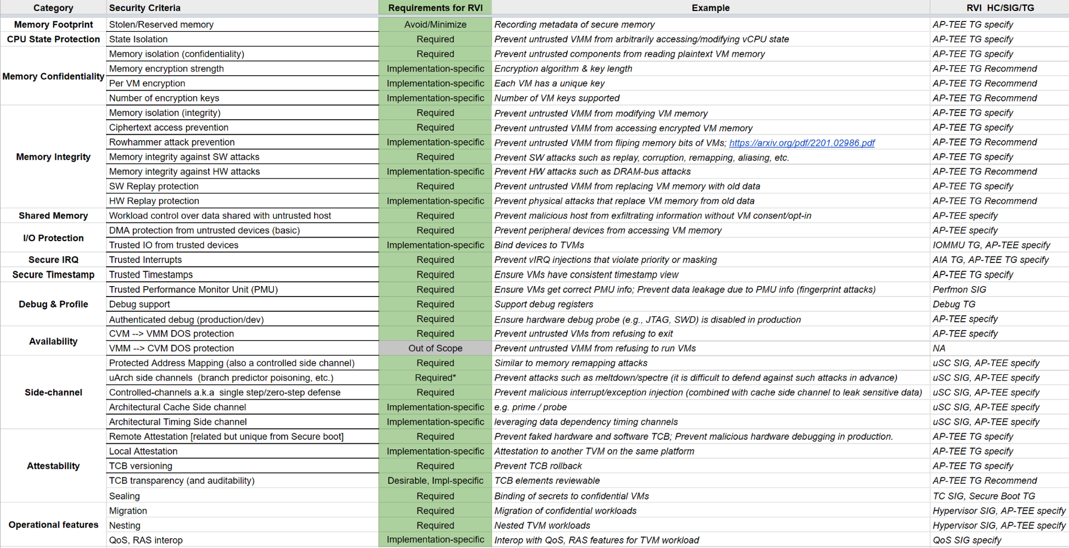

Slide 16
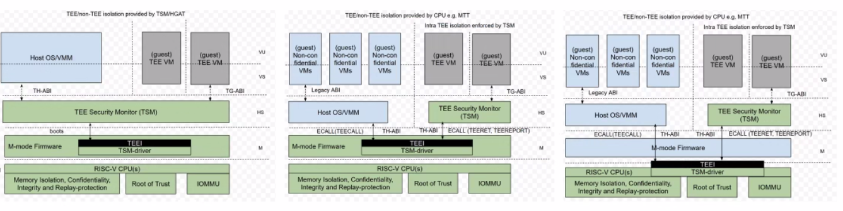
Current Deployment Models

